Slide 1
UNIFIED EXPERIENCE PLATFORM (UXP)

Slide 2
OUR GOALS / WHY UXP?

Slide 3
OUR GOALS / WHY UXP?
VISION
BUSINESS STRATEGY
STEPS
WHAT
WHY
HOW
Momentum will implement a unified data solution that integrates data from disparate sources into a single view, providing accurate answers to critical questions.
A standardized and repeatable process is required for scheduling and recording activation data.
Create an application that will be to source of the truth for all activations within momentum.
Create a database that creates and stores all GUIDS and UIDs for both Campaigns and Events.
UXP technology will:
Streamline data collection.
Provide a centralized location.
Create a standard method when joining to 3rd Party
Data process discovery
Developing an application that can gather and unify data, allowing users to edit all data
Bi-directional API: Send & and receive event Information to any required system to create an event and receive back IDs so that bidirectional updates can be performed from either system.
Data governance: create a method to ensure data quality and completeness.
Training: All teams on how to enter events into the new application
PRODUCT
AIM
EXECUTE

Slide 4

USER PERSONA
PERSONA:
GOALS:
Name of Persona: Business Leaders & Project Managers Role: Familiar with account teams and account event scheduling, communicates with Clients' to understand number of events, event details, scope and timing for execution
A process to keep all campaigns & events up to date.
One source of truth for all event scheduling
Mitigate multiple spreadsheets and Smartsheets where events are tracked
Review upcoming and past events for planning
DESCRIPTION:
CHALLENGES:
My job is to oversee and drive the successful execution and delivery of projects within the agency, through building and orchestrating project plans across the business.
As a Business Leader or Project manager, I would like to have one location to track events for my client campaigns.
View upcoming, past, and scheduled events in a list and a calendar. I sometimes am required to provide Client with lists of events per region or team
All of my events require a unique QR code, I would like to tie each event with a QR code in an easier way to control and test.
Any event that requires BA recaps should talk to our field marketing platform to capture event metrics
Once executed, all final data should be sent to MOMO Bi
Siloed communication: change requests between client and production teams
Large volumes & multiple locations to track the same information
Multiple stakeholders in projects
WORKFLOW & FEATURES USED:
Scheduling event data: Event Name, Date, Location, Team
Assigning events to Field Marketing system
QR Code generation within UXP
Calendar and Event list within UXP

Slide 5
BENEFITS
Our primary audience is business leaders and project managers who are in charge of activations.
​DELIVERABLE | ​BENEFIT ​ | PAIN SOLVED ​
​Front End | ​Centralized management of all activation data ​ | Scattered and disorganized data across multiple systems ​
Database | ​All GUIDs, and base Information. Can be enriched with additional IDs and transactional data from 3rd party systems | ​Difficulty in tracking and managing events ​and multiple systems Manual GUID creation
APIs | Will connect bi-directional API's with third party systems | Manual downloads of data and manual data mapping
Training & Documentation | Streamline training and documentation across business units | Lack of unified training across teams and offices

Slide 6
TECHNOLOGY APPROACH

Slide 7











UNIFIED SYSTEMS VISION
ACTIVATIONS
TRACE
FIELD MANAGEMENT
LOCATION & EVENT INTELLIGENCE
rTAG
PROJECT
SCOPES
TIME
FEES
RESOURCES
CONTENT
GENERATIVE AI
DAM
APPROVALS
COGNITIVE SERVICES (AI/ML)

Slide 8

TODAY
Momentum gathers meaningful post-event metrics by unifying data from different sources.
Information is either not available or not shared in a timely manner.
This limits Momentums spend and agility when generating insights.

Slide 9
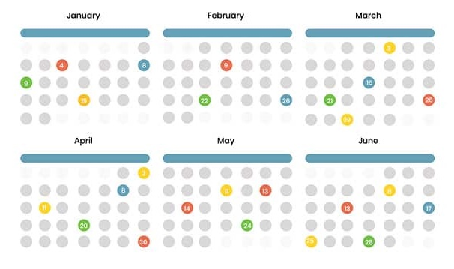









UNIFIED EXPERIENCE DATA ECOSYSTEM
Unified data aggregates data from disparate sources into a single view providing complete and accurate answers to critical questions.
Activation Schedule
Unified Experience Platform (UXP) and Input Procedure A front-end Input application and organization-wide process/system for collecting Activation Details and information: Activation Name, Activation Date, Activation Client, and Activation Location.
Unified Experience Data
Activation Insights
Field Management Portfolio-wide standardized system for managing event details, assets, and on-site wrap information. It includes a cloud/web-based tool accessible from anywhere for real-time updates and version control, eliminating the need for multiple spreadsheets.
Conversational Insights
Other systems: Walmart Hub, Splash, Placer data, Client owned systems
Cognitive Services

Slide 10





UXP COMPONENTS AND FLOW
USER INTERFACE
DATA
CAMPAIGN
New entry
DATABASE
EVENT
EVENT
Update data
Other system data
Other system data
Log data
EVENT
EVENT
CAMPAIGN ID
EVENT ID
EVENT ID
Other system data
Other system data
Display data
CAMPAIGN DATA
EVENT DATA
EVENT DATA
SYS DATA
Some apps will have a connection to Create entries
And send data back
Update data
OTHER SYSTEMS ENRICHMENT & COLLECTION
AUTOMATION
Interrogate data
SURVEYS
QR CODES
SCHEDULE
FIELD MANAGEMENT
LOCATION
Receive information
OTHER
OTHER

Slide 11


UXP COMPONENTS AND FLOW
USER INTERFACE
DATA
AI & INSIGHT
CAMPAIGN
DATABASE
EVENT
EVENT
Other system data
Other system data
EVENT
EVENT
CAMPAIGN ID
EVENT ID
EVENT ID
Other system data
Other system data
CAMPAIGN DATA
EVENT DATA
EVENT DATA
SYS DATA
OTHER SYSTEMS ENRICHMENT & COLLECTION
AUTOMATION
SURVEYS
QR CODES
SCHEDULE
FIELD MANAGEMENT
LOCATION
OTHER
OTHER

Slide 12
KEY FEATURES
FEATURE | BENEFIT | PAIN SOLVED
Unified Experience Platform (UXP) | Centralized management of activation data | Scattered and disorganized data across multiple systems
Master Program ID & Event ID | Unique identifiers for each campaign and event | Difficulty in tracking and managing events
API Integration | Seamless communication with field management systems | Manual data transfer and synchronization
Unified Database | Consolidated data storage | Redundancy and inconsistency in data storage
Calendar View | Easy visualization of scheduled events | Inefficient event planning and tracking
Intuitive User Interface & User Journeys | Streamlined navigation and workflows tailored to different user roles and actions | Offline and fragmented user experiences that lead to redundancy and inefficiencies
Client Power BI Dashboards | Customizable data visualization for clients | Limited client access to data and insights
Synchronization Between Systems | Real-time data updates across UXP and field management systems | Inconsistent data between systems
Permissions & Access Control | Per client team | Partitioning clients depending on accounts
Input And Update Data In Both Systems | Flexibility in managing activation and event wrap data | Inflexible data management process

Slide 13
POWER PLATFORM PROOF OF CONCEPT

Slide 14
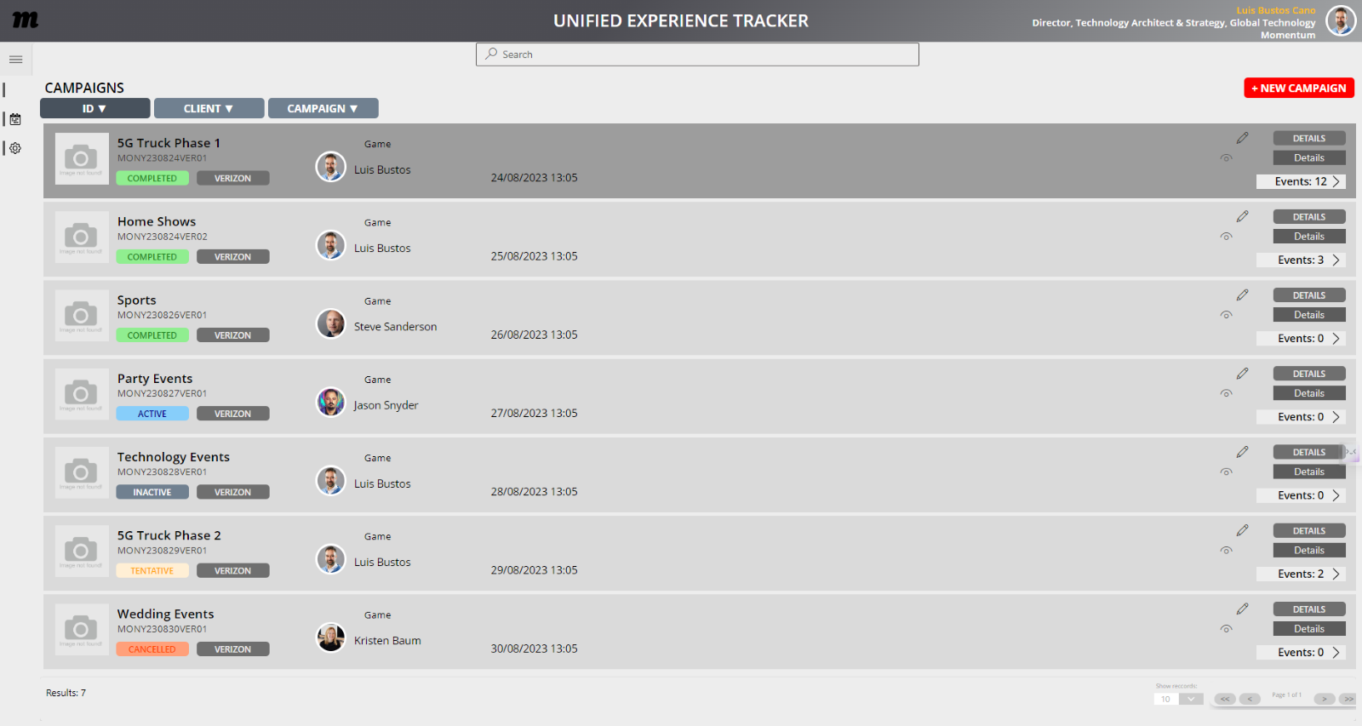
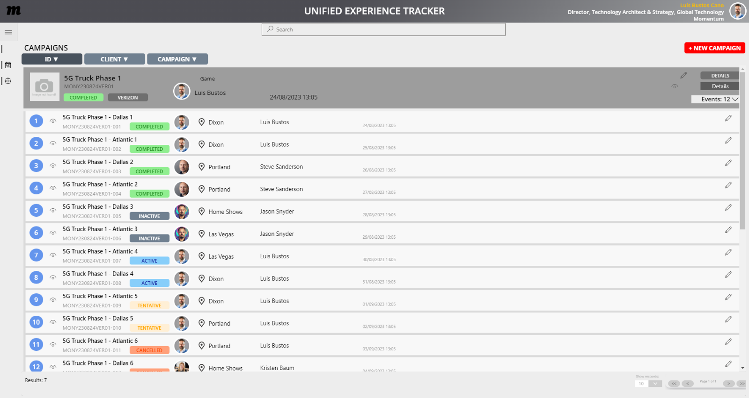
CAMPAIGNS & EVENTS
Create, edit, delete Events
Display Event data
Create an intelligible campaign ID
Sorting search returns based on criteria: ID, Name, Status, etc
Pagination
Retrieve AD data for event originator/assignee
Display map data and standardized address

Slide 15
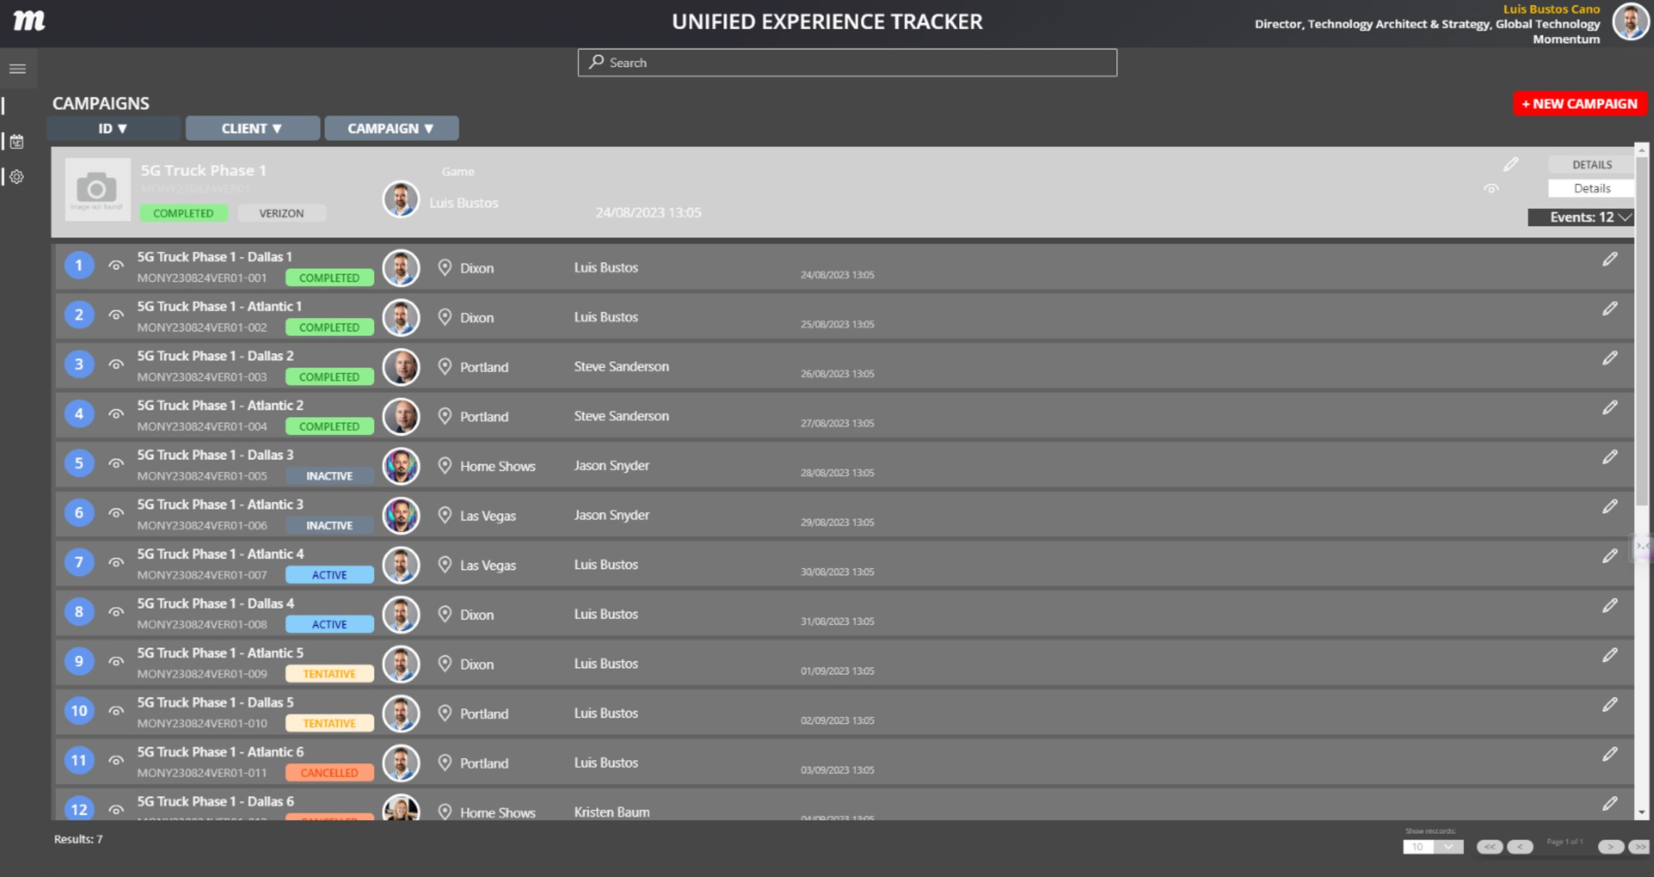
CAMPAIGNS & EVENTS
TURES
Theme variations stored at user-level permissions
This can include read/write permissions or view only permissions
Configurable by:
Client
User
Team

